Slide 1
Old McDonald
Music by:
Members of York Region Preschool Speech and Language Program
Pictures Courtesy of:

Slide 2
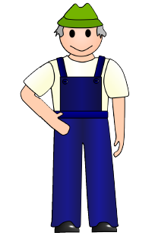
Old McDonald had a farm
E-I-E-I-O

Slide 3
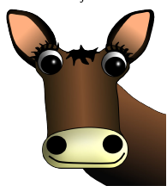
And on that farm he had a cow
E-I-E-I-O

Slide 4
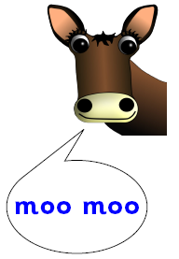
With a moo-moo here, and a moo-moo there,
Here a moo, there a moo, everywhere a moo-moo

Slide 5
Old McDonald had a farm
E-I-E-I-O

Slide 6
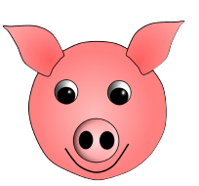
And on that farm he had a pig
E-I-E-I-O

Slide 7
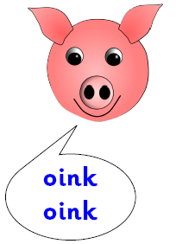
With an oink oink here, and an oink oink there,
Here an oink, there an oink, everywhere an oink oink

Slide 8
Old McDonald had a farm
E-I-E-I-O

Slide 9
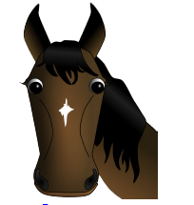
And on that farm he had a horse
E-I-E-I-O

Slide 10
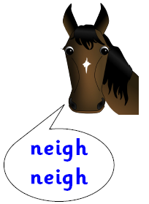
With a neigh neigh here, and a neigh neigh there,
Here a neigh, there a neigh, everywhere a neigh neigh

Slide 11
Old McDonald had a farm
E-I-E-I-O

Slide 12

And on that farm he had a sheep
E-I-E-I-O

Slide 13
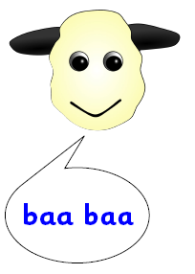
With a baa baa here, and a baa baa there,
Here a baa, there a baa, everywhere a baa baa

Slide 14
Old McDonald had a farm
E-I-E-I-O

Slide 15
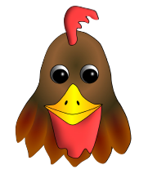
And on that farm he had a hen
E-I-E-I-O

Slide 16
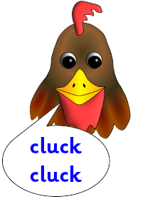
With a cluck cluck here, and a cluck cluck there,
Here a cluck, there a cluck, everywhere a cluck cluck

Slide 17
Old McDonald had a farm
E-I-E-I-O

Slide 18
The End

