Slide 1
The Wheels on the Bus
Music by:
Members of York Region Preschool Speech and Language Program
Pictures Courtesy of:

Slide 2
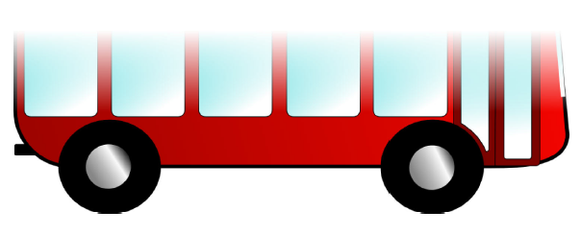
The wheels on the bus go round and round, round and round, round and round

Slide 3
The wheels on the bus go round and round,
All through the town!

Slide 4
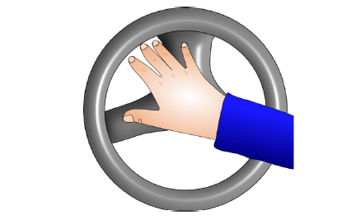
The horn on the bus goes beep beep beep,
Beep beep beep, Beep beep beep

Slide 5
The horn on the bus goes beep beep beep,
All through the town!

Slide 6
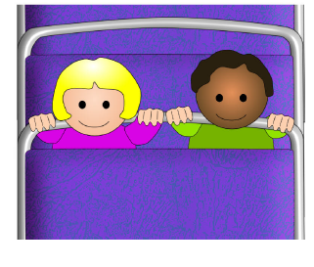
The babies on the bus go wah wah wah, wah wah wah, wah wah wah

Slide 7
The babies on the bus go wah wah wah,
All through the town!

Slide 8
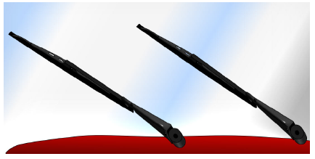
The wipers on the bus go swish swish swish,
Swish swish swish, Swish swish swish

Slide 9
The wipers on the bus go swish swish swish,
All through the town!

Slide 10

The doors on the bus go open and shut, open and shut, open and shut

Slide 11
The doors on the bus go open and shut,
All through the town!

Slide 12
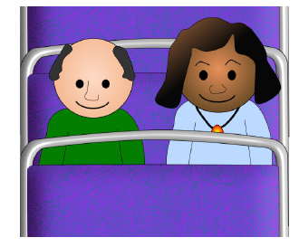
The people on the bus go up and down, up and down, up and down

Slide 13
The people on the bus go up and down,
All through the town!

Slide 14
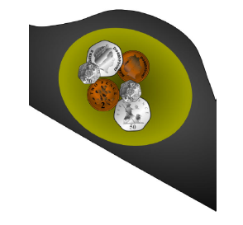
The money on the bus goes clink clink clink, clink clink clink, clink clink clink

Slide 15
The money on the bus goes clink clink clink,
All through the town!

Slide 16
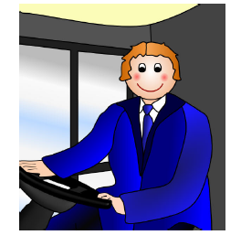
The driver on the bus says “Move on back, move on back, move on back”

Slide 17
The driver on the bus says “Move on back”,
All through the town!

Slide 18
The End

